Slide 1
CS 540 Network Architecture
Lecture 12: Future Internet, packet classification
Prof. Younghee Lee

Slide 2
Future of the Internet?
Future Network?
We’re here
The Internet
1st Jan 1983. ===➔ Flag day
ARPAnet switched from NCP to TCP/IP
About 400 machines need to switch.
As the Internet get bigger, it get much harder to change : Flag day?
Maybe we reach to almost the summit of the networking system based on the paradigm of the Internet which are “distributed control, stateless,….”
Evolution?
New requirements: mobility, security, NM, content dissemination…
Small improvement, higher cost, complexity…
Future of the Internet?:
Optimistic view: many new challenges for disruptive technologies
Pessimistic view: networking research is at the end
Realistic? View: continuous evolution and change
The Internet paradigm

Slide 3

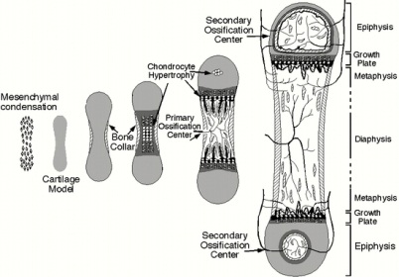
IP evolvability [Kurose]
IP
difficulty: extending existing infrastructure
investment in legacy systems
economic incentives?
works well enough: “if it ain’t broke, don’t fix it”
ossification as a result of success?
approaches towards evolution:
active (extensible) networks: programmability in net “core”
overlays: programmability at the “edge”
IP convergence!!!
Straight Jacket
Ossification

Slide 4
Future of the Internet?
Vision
Virtual world, virtualization of network
Connectivity oriented network -> content oriented network
Service creation by consumer : producer
Context aware networking: user context, environment context
Mobile Internet, multi-sensory information
Virtual real world with emotion [6]
[5]

Slide 5
Evolutionary or Clean Slate?
Plant the seeds that enable future research experiments*
Testbed
Insights from clean slate research help guide the ongoing evolution
Internet as evolving ecosystem*
Internet monitoring, estimation of traffic flow,
Better network
Additional value > Transition cost
Market will decide.
* Jennifer Rexford, Constatine Dovrolis “Future Internet Architecture: Clean-Slate Versus Evolutionary Research” Communications of the ACM Sep. 2010
=================================================================================
Additional value > Transition cost: How?
Need intelligent & composable open architecture
Smart network, Smart node: “fit for purposes”

Slide 6


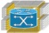
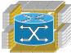


Smart Network
Web 3.0
Ecosystem
Semantic Web
Application platform
Linked open Data
Smart Network app. platform
Legacy Internet service, IMS
Smart Network
services
Future Internet
Smart Network
Cloud
Server
: Smart node
: PTN
Backbone
4G/5G
Network Virtualization
wired
wireless
WDM-PON, OFDM
Enterprise Network
Super WiFi
FTTH
1~10Gbps

Slide 7
Internet Plan for future in Korea
Korea Communications Commission (KCC)
National Agenda for future of the Internet :
Long term big national initiative
Future Internet Promotion Committee : 2010.6 ~
Internet Plan for future:
Report to President of Republic of Korea at 29th June 2011

Slide 8

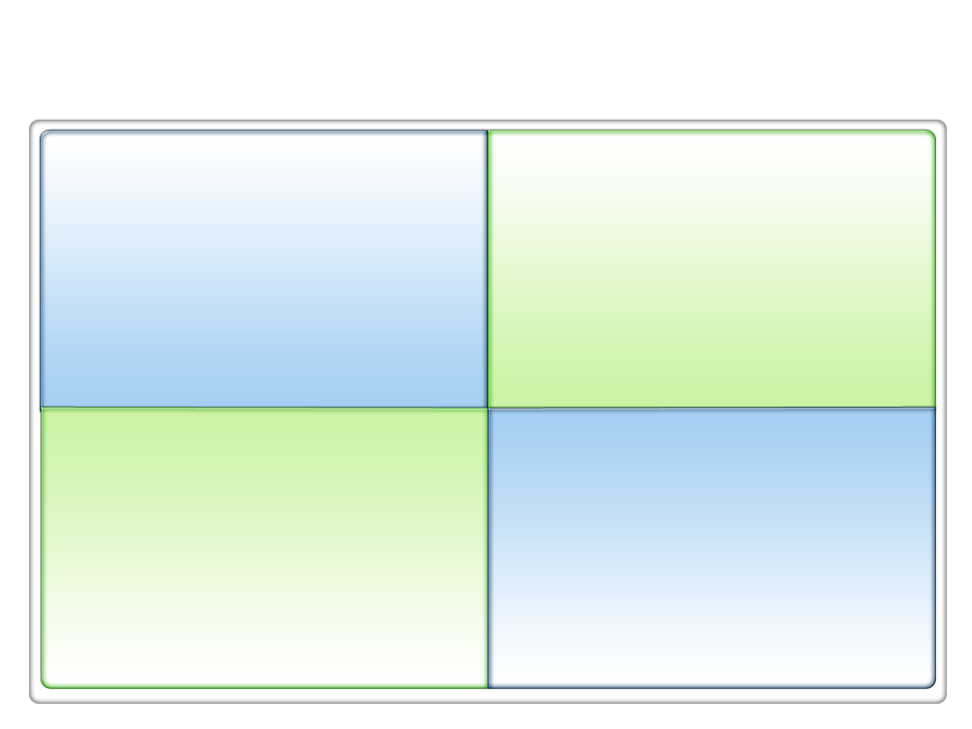
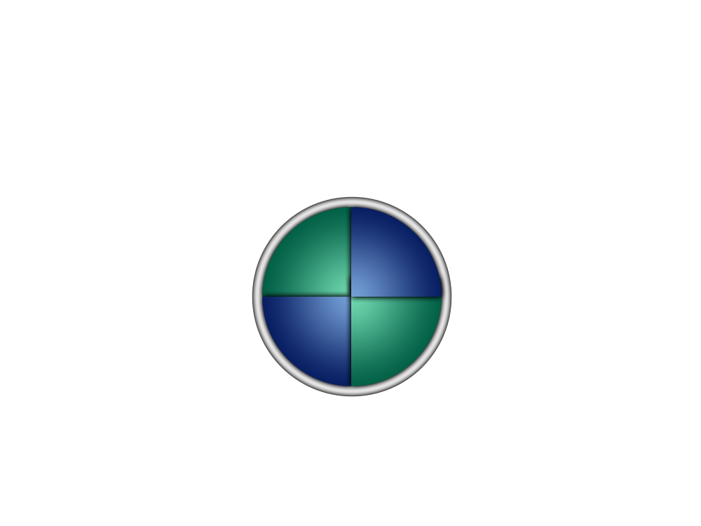
Vision & Strategy
Total Investment
Government $500M, Private sector $37B for 5 years
Future Network Infra
- Wireless Network
- Optical network
Future Internet R&D
Global R&D Collaboration
Key Technology
Infra
Promotion plan for
New Internet Industry
- Cloud, Contents
- Internet Startup Company
Globalization
Security
Secure Internet
Internet Culture
<PPP>
Notes:
순서대로 숫자

Slide 9
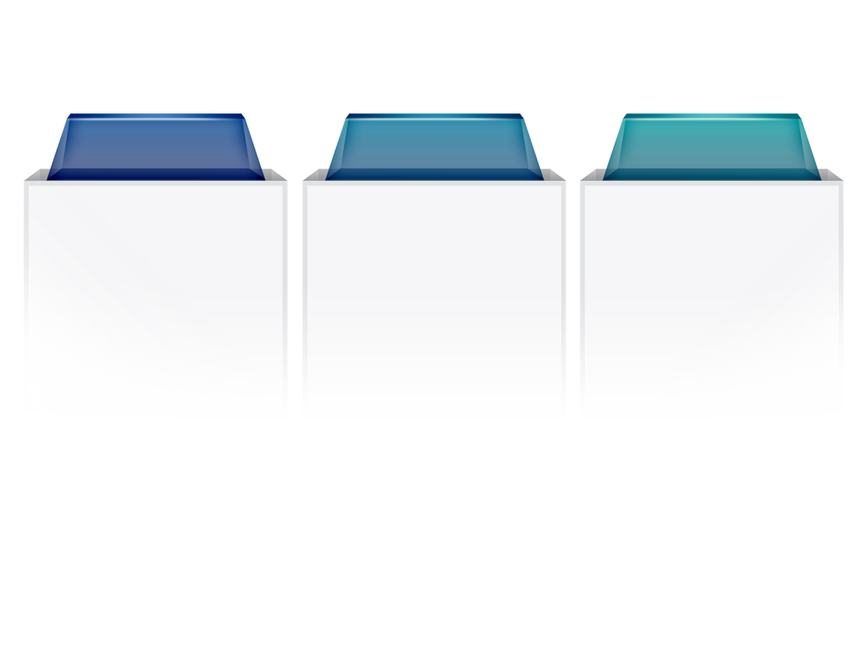
Future Network Infrastructure
100 times faster Internet until 2020
- Investment $7B/year from ISP -
Network Infra
Frequency band
4G Service
- LTE : Seoul ’11 ⇒ Nationwide ’14
- WiBro
Available bandwidth :
- Two times more
Analog TV : ~ Dec. 2012
Channel(108MHz) , White space
Gigabit Internet: ’12
⇒ 10Gbps: ’20
Network Infra structure for Video and High volume contents oriented Internet service: ’20
-7-

Slide 10






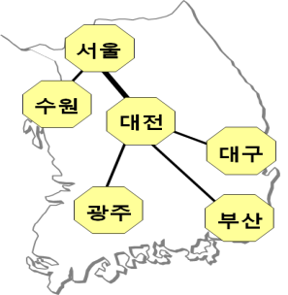

Future Internet R&D, Global Collaboration
Future Internet Technology
Global Testbed
Investment: $250M 2011 ~ 2015
KOREN
- 10~20Gbps 100Gbps
- Univ./RI open to industry and
public
Mobility, Trustworthy, Content Centric Networking …
TEIN center: 2012
Green Internet
* TEIN : Trans Eurasia Information Network
KOREN
Next Generation User Interface, Semantic web
Europe
TEIN
Korea

Slide 11
Internet in Korea: 2010 – report of ITU sep., 2011
Penetration: 97% of household
Building & Apt. built since 1995
Broadband Certification System => 36.6% of Fiber connection
Giga(bit) Internet pilot project
Includes 100Mbps broadband networks in rural area
Mobile broadband penetration: 91%
Korea tops the ICT Development Index(IDI) by ITU
ICT diffusion
ICT use sub-index
ICT skills sub-index
ICT network Infra
.

Slide 12
Jianli Pan et al., “A Survey of the Research on Future internet architectures”
KEY RESEARCH TOPICS
Content- or data-oriented paradigms
Mobility and ubiquitous access to networks
Cloud-computing-centric architectures
Security
Experimental testbeds

Slide 13
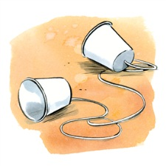

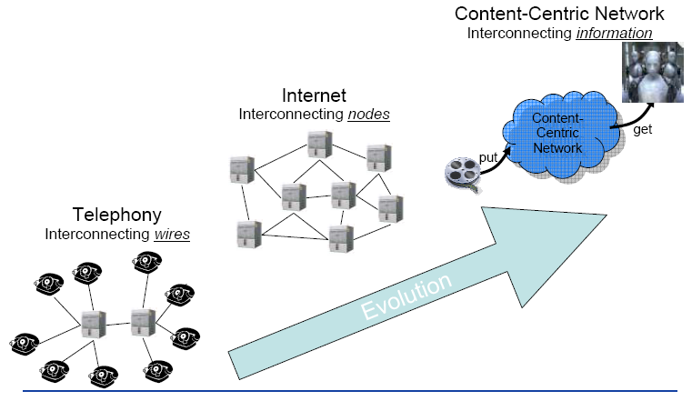
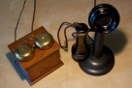
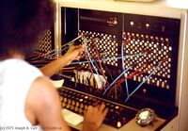

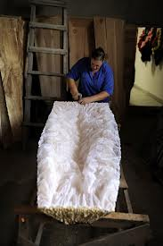

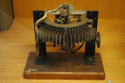
The Third Generation of Networking?
Just an example
At the beginning:
Overlay Networks of telephone networks
At the beginning:
Overlay Networks of ip networks
Mr. Strowger
1891
Overlay Network: network built upon top of underlying network. Connecting nodes with virtual links
T. Zahariadis et al., “Future Content-Centric Internet Architecture”, FIA 2009

Slide 14
Content- or data-oriented paradigms
Vision
Find the path to the content (vs. Find the path to the host with ip)
http://www.datacenterdynamics.com/content-tracks/security-risk/major-ddos-attack-on-dyn-disrupts-aws-twitter-spotify-and-more/97176.fullarticle
CCN or NDN are safer from DDOS attack?

Slide 15
Content-Centric Network : Van Jacobson
Content traffic in 2008
500 exabyte (10¹⁸)
Networking with Named data
Rather than named hosts
Content chunk
simplicity in content routing
Simplified lower layer (L2)
Strategy: can select a optimum path according to the situation
Security: secure content itself (Signature)
Rather than secure connection
Broadcast
Multiple receivers can receive the content sharing the named data
Van Jacobson et al., “Networking Named Content”, CoNEXT 2009, Rome, Italy

Slide 16
Mobility and ubiquitous access to networks
Vision
Mobility as the norm
New Network Architecture
Scalable, secure,….
Not evolutionary

Slide 17
Cloud-computing-centric architectures
Vision
Virtual world, virtualization of
A major technical challenge
how to guarantee the trustworthiness of users while maintaining persistent service availability.

Slide 18
Security
Security was added into the original Internet as an additional overlay instead of an inherent part of the Internet architecture.
network architecture for security? Not an inherent part of the Internet architecture.

Slide 19
Experimental testbeds
Developing new Internet architectures requires large-scale testbeds.
Testbed research includes
multiple testbeds with different virtualization technologies, and the federation and coordination among these testbeds.
United States, EU, Asian countries.

Slide 20
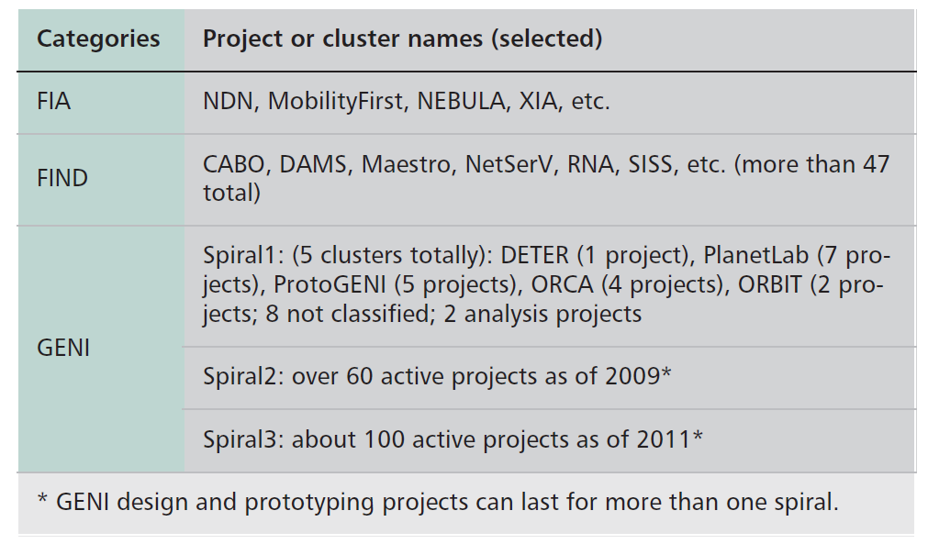
U.S. projects and clusters on the future Internet.

Slide 21
Named Data Networking (NDN)
The NDN uses a different model that enables the network to focus on “what” (contents) rather than “where” (addresses).
The data are named instead of their location (IP addresses).

Slide 22
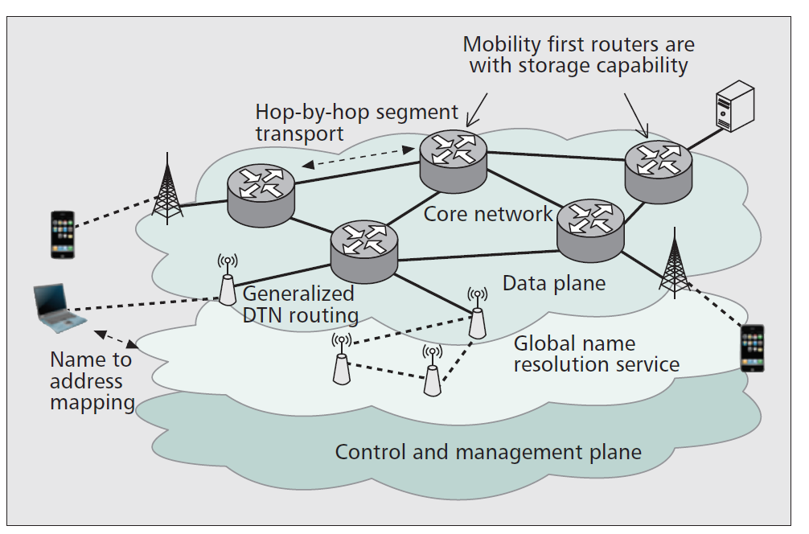
MobilityFirst
Short term goals:
Addressing the cellular convergence
Providing mobile p2p and infostation (DTN) application services.
Long term: V2V and V2I modes
Location services, georouting, and reliable multicast

Slide 23
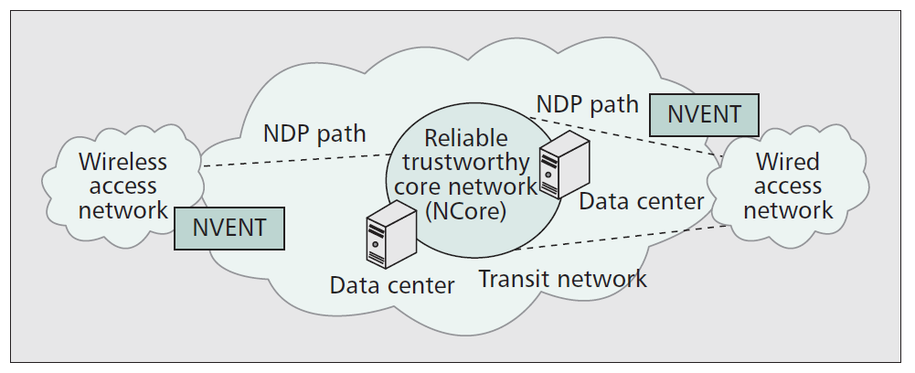
NEBULA
Building a cloud-computing-centric network architecture.

Slide 24
eXpressive Internet Architecture (XIA)
Directly and explicitly targets the security issue within its design
Define a rich set of building blocks or communication entities as network principals including hosts, services, contents, and future additional entities.
It is embedded with intrinsic security by using self-certifying identifiers for all principals for integrity and accountability properties.
A pervasive “narrow waist” (not limited to the host-based communication as in the current Internet) for all key functions, including access to principals, interaction among stakeholders, and trust management; it aims to provide interoperability at all levels in the system, not just packet forwarding.

Slide 25
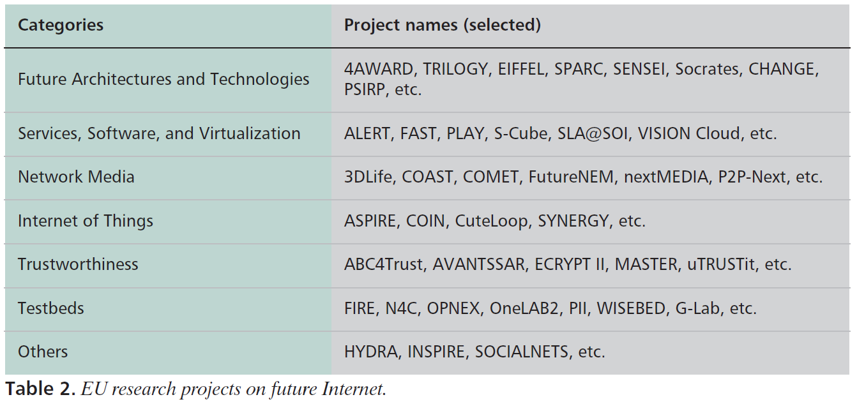
RESEARCH PROJECTS FROM EU

Slide 26
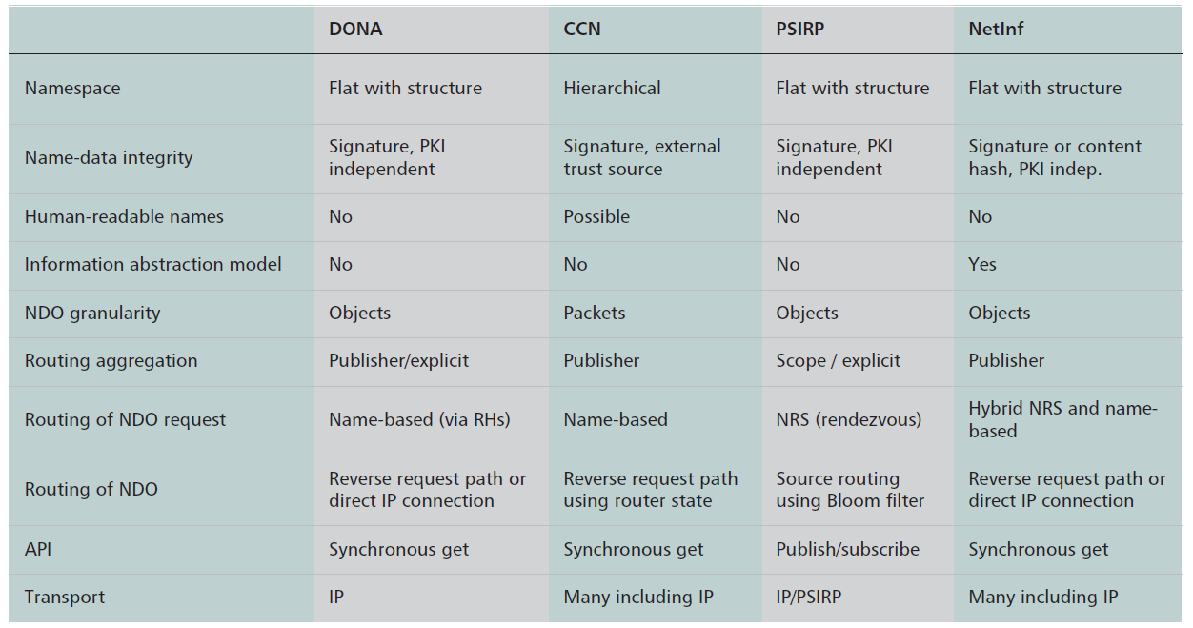
ICN
Source: ‘A Survey of Information-Centric Networking’ Bengt Ahlgren et al., IEEE Communications Magazine July 2012

Slide 27
RESEARCH PROJECTS FROM ASIA
JAPAN
CHINA
KOREA

Slide 28
Packet classification

Slide 29
Packet classification
Packet classification
The process of categorizing packets into “flows” in an Internet router
All packets belonging to the same flow obey a predefined rule and are processed in a similar manner(action) by the router
Key technology for “open flow” and “SDN”
Flow-aware router: keeps track of flows and perform similar processing on packets in a flow
Non best effort services, firewalls, QoS
Flow-unaware router (packet-by-packet router): treats each incoming packet individually

Slide 30
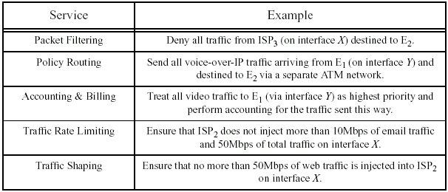
Example of Classification Rules
Access-control in firewalls
Deny all e-mail traffic from ISP-X to Y
Policy-based routing
Route IP telephony traffic from X to Y via ATM
Differentiate quality of service
Ensure that no more than 50 Mbps are injected from ISP-X
Committed Access Rate (rate limiting)
Rate limit WWW traffic from sub­interface#739 to 10Mbps
Traffic measurement: ftp?, p2p?...

Slide 31
Multi-field Packet Classification
 | Field 1 | Field 2 | … | Field k | Action
Rule 1 | 5.3.90/21 | 2.13.8.11/32 | … | UDP | A₁
Rule 2 | 5.168.3/24 | 152.133/16 | … | TCP | A₂
… | … | … | … | … | …
Rule N | 5.168/16 | 152/8 | … | ANY | A_{N}
Given a classifier with N rules, find the action associated with the highest priority rule matching an incoming packet.
Example: packet (5.168.3.32, 152.133.171.71, …, TCP)
Notes:
We are given a classifier consisting of n rules. A rule has k fields also called as dimensions, each corresponding to a particular field in the packet header e.g. source and destination IP address or port number or protocol or may be even higher layer fields. Every rule specifies a prefix,a range, a wildcard or any other simple regular expression on each of the k fields. k is the number of dimensions of classification. A rule also has an action associated with it. An incoming packet is said to match a particular rule R, if all fields in the packet’s header match the respective field specifications of rule R. Now a packet may match multiple rules. In that case, the rule with the highest priority is considered. Usually, the order in which rules appear determines their relative priority. As an example a packet …
An example classifier would be access lists in a company firewall where rules determine which packets to allow and which to deny access to the company’s network. In this example actions would be of two types: allow or deny. Another example, that of a 1D classifier, would be destination address forwarding table in a router. Here rules specify prefixes on the destination IP address and actions specify next hops where the matching packets need to be sent to.
Hence packet classification is an important functionality required in routers for differentiated services.

Slide 32
Complexity: Hard Problem
N rules and k header fields for k > 2
O(log N^{k-1}) time and O(N) space
O(log N) time and O(N^{k}) space
How many rules?
Largest for firewalls & similar → 1700
Diffserv/QoS → much larger → 100k (?)
How many actions? : limited number

Slide 33
Flow-aware Router: Basic Architectural Components
Routing, resource reservation, admission control, SLAs
Control
Packet classification
Special processing
Switching
Datapath:
per-packet
processing
Routing lookup
Scheduling

Slide 34
Example 4D classifier
Rule | L3-DA | L3-SA | L4-DP | L4-PROT | Action
R1 | 152.163.190.69/255.255.255.255 | 152.163.80.11/255.255.255.255 | * | * | Deny
R2 | 152.168.3/255.255.255 | 152.163.200.157/255.255.255.255 | eq www | udp | Deny
R3 | 152.168.3/255.255.255 | 152.163.200.157/255.255.255.255 | range 20-21 | udp | Permit
R4 | 152.168.3/255.255.255 | 152.163.200.157/255.255.255.255 | eq www | tcp | Deny
R5 | * | * | * | * | Deny
Example Classification Results
Pkt Hdr | L3-DA | L3-SA | L4-DP | L4-PROT | Rule, Action
P1 | 152.163.190.69 | 152.163.80.11 | www | tcp | R1, Deny
P2 | 152.168.3.21 | 152.163.200.157 | www | udp | R2, Deny

Slide 35
Classification is a Generalization of Lookup
Classifier = routing table
One-dimension (destination address)
Rule = routing table entry
Regular expression = prefix
Action = (next-hop-address, port)
Priority = prefix-length
Longest Prefix Matching for routing lookups is a special-case of one-dimensional packet classification

Slide 36
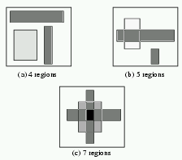
Example
Two-dimension space, i.e., classification based on two fields
Complexity depends on the layout, i.e., how many distinct regions are created
Number of region:
n-rule in F dimension
O(n^{F})

Slide 37
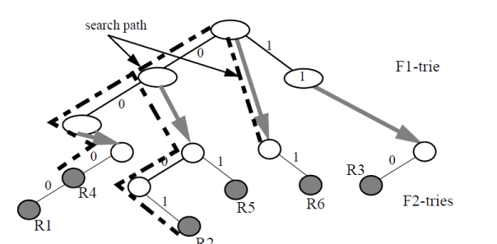
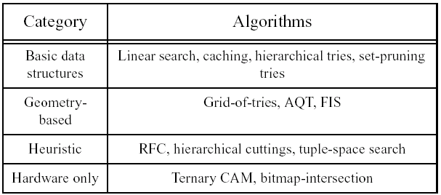
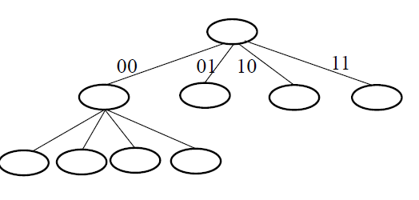
Classification algorithm
Linear search
The simplest data structure is a linked list of rules stored in order of decreasing priority
O(N) storage, O(N) lookup time, O(1) update complexity

Slide 38
Hierarchical Tries
Search (000,010)
Rule | DA | SA
R1 | 0* | 10*
R2 | 0* | 01*
R3 | 0* | 1*
R4 | 00* | 1*
R5 | 00* | 11*
R6 | 10* | 1*
R7 | * | 00*
Dimension DA
1
0
0
0
O(NW) memory
O(W²) lookup
R3
R4
R6
Dimension SA
R5
R2
R1
R7

Slide 39
Set-pruning Tries [Tsuchiya, Sri98]
Search (000,010)
Rule | DA | SA
R1 | 0* | 10*
R2 | 0* | 01*
R3 | 0* | 1*
R4 | 00* | 1*
R5 | 00* | 11*
R6 | 10* | 1*
R7 | * | 00*
Dimension DA
1
0
0
0
O(N²) memory
O(2W) lookup
R4
R3
R6
Dimension SA
R7
R2
R1
R5
R7
R2
R1
R7
R7

Slide 40
Grid-of-Tries [Sri98]
Search (000,010)
Rule | DA | SA
R1 | 0* | 10*
R2 | 0* | 01*
R3 | 0* | 1*
R4 | 00* | 1*
R5 | 00* | 11*
R6 | 10* | 1*
R7 | * | 00*
Dimension DA
1
0
0
0
0
O(NW) memory
O(2W) lookup
0
0
R3
R4
0
R6
Dimension SA
R5
R2
R1
R7

Slide 41
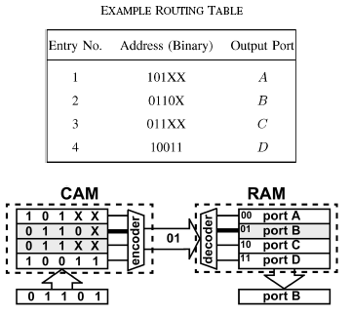
Lookups/Classification with Ternary CAM
TCAM becomes larger, cheaper, and faster as time goes by.
Notes:
We have seen that it is quite difficult for a classification algorithm to achieve both speed and modest storage in the worst case. We have found that real classifiers have considerable structure. This makes possible comparatively simple classification schemes which exploit the structure inherent in a classifier. In this talk we saw one such scheme, called RFC which appears to work very well with a selection of classifiers available to us. There fore it seems to be of practical use in applications where classifiers do not change more frequently than a few rules per second on average.
Thanks, that concludes my talk but before we go to questions I would like to appeal to all the members of the audience who work in ISP companies. Researchers working on packet classification need to get access to larger and larger databases of rules. While I understand the business reasons why the ISPs won’t make their policy databases public, I have a set of scripts which would just sanitize them while preserving their structure. So please email me or talk to me if you could help the research community with this. Thanks.

Slide 42
TCAM: Range-to-prefix explosion
Maximum memory blowup = factor of (2W-2)^{d}
Rule | Range
R1 | [3,11]
R2 | [2,7]
R3 | [4,11]
R4 | [4,7]
R5 | [1,14]
Maximal Prefixes
0011, 01**, 10**
001*, 01**
01**, 10**
01**
0001, 001*, 01**, 10**, 110*, 1110

Slide 43
Classification with TCAM
The total # of TCAM entries needed to represent a rule is
Product of the # of TCAM entries needed to represent its range clauses
A rule for two 16 bit field => (2x16 – 2) x (2x16 -2) = 900!
semantically equivalent rule set that requires less TCAM entries to represent => various approaches
Multiple Chunks
. . .
Notes:
We have seen that it is quite difficult for a classification algorithm to achieve both speed and modest storage in the worst case. We have found that real classifiers have considerable structure. This makes possible comparatively simple classification schemes which exploit the structure inherent in a classifier. In this talk we saw one such scheme, called RFC which appears to work very well with a selection of classifiers available to us. There fore it seems to be of practical use in applications where classifiers do not change more frequently than a few rules per second on average.
Thanks, that concludes my talk but before we go to questions I would like to appeal to all the members of the audience who work in ISP companies. Researchers working on packet classification need to get access to larger and larger databases of rules. While I understand the business reasons why the ISPs won’t make their policy databases public, I have a set of scripts which would just sanitize them while preserving their structure. So please email me or talk to me if you could help the research community with this. Thanks.

Slide 44
Recursive Flow Classification [Gupta99]
Observations:
Difficult to achieve both high classification rate and reasonable storage in the worst case
Real classifiers exhibit structure and redundancy
A practical scheme could exploit this structure and redundancy
Notes:
We have seen that it is quite difficult for a classification algorithm to achieve both speed and modest storage in the worst case. We have found that real classifiers have considerable structure. This makes possible comparatively simple classification schemes which exploit the structure inherent in a classifier. In this talk we saw one such scheme, called RFC which appears to work very well with a selection of classifiers available to us. There fore it seems to be of practical use in applications where classifiers do not change more frequently than a few rules per second on average.
Thanks, that concludes my talk but before we go to questions I would like to appeal to all the members of the audience who work in ISP companies. Researchers working on packet classification need to get access to larger and larger databases of rules. While I understand the business reasons why the ISPs won’t make their policy databases public, I have a set of scripts which would just sanitize them while preserving their structure. So please email me or talk to me if you could help the research community with this. Thanks.

Slide 45
RFC: Classifier Dataset
793 classifiers from 101 ISP and enterprise networks with a total of 41505 rules.
Classifier (policy database)
40 classifiers: more than 100 rules. Biggest classifier had 1733 rules.
Maximum of 4 fields per rule: source IP address, destination IP address, protocol and destination port number.
Notes:
Acknowledgments. Say that they are manually entered. And originate largely from acls or firewalls, and hence are updated very infrequently, for example only at router boot time.

Slide 46
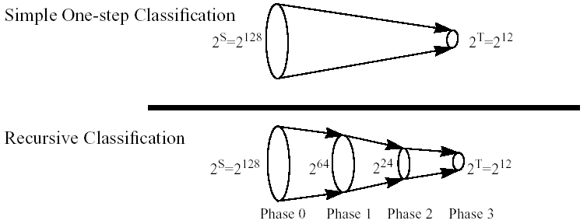
RFC:
Problem formulation:
Map S bits (i.e., the bits of all the F fields) to T bits (i.e., the class identifier, T= logN, N rules)
Main idea:
Create a 2^{S} size table with pre-computed values; each entry contains the class identifier
Only one memory access needed
…but this is impractical → require huge memory
Use recursion: trade speed (number of memory accesses) for memory footprint
3 phases
Notes:
Acknowledgments. Say that they are manually entered. And originate largely from acls or firewalls, and hence are updated very infrequently, for example only at router boot time.

Slide 47
The RFC Algorithm
At each stage the algorithm maps one set of values to a smaller set
A set of memories return a value shorter than the index of the memory access
Split the F fields in chunks
1. Use the value of each chunk to index into a table
Indexing is done in parallel
2. Combine results from previous phase, and repeat
3. In the final phase we obtain only one value that is action

Slide 48
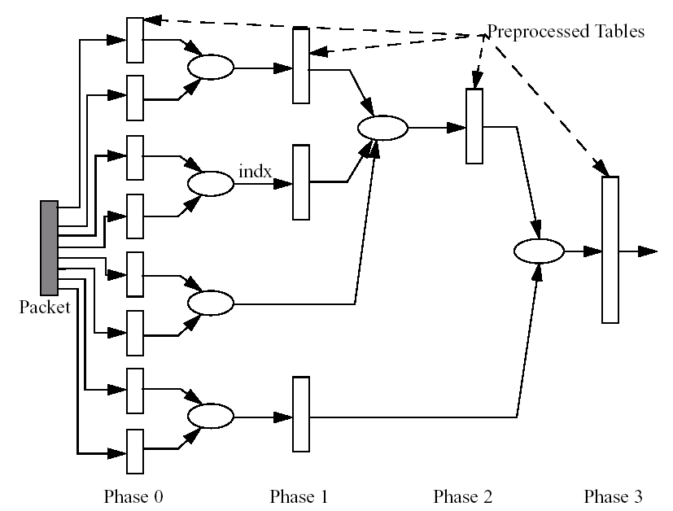
The RFC Algorithm
16bits
16bits
Chunk #0
Source L3 Address
Destination L3 Address
class ID
L4 protocol and flags
Source L4 port
Destination L4 port
Chunk #7
Type of Service
Packet Header

Slide 49
Deep packet inspection
A form of packet filtering examining the data part of packet and possibly header part
defined criteria to decide
whether the packet may pass or
if it needs to be routed to a different destination, or,
for the purpose of collecting statistical information.
Applications
Advanced network management
Security, viruses, spam, intrusion ; firewall
internet data mining, eavesdropping, and internet censorship
ISP(protection from VoIP traffic), Government(national security)
Problem?
net neutrality
fear that DPI may be used anti-competitively or to reduce the openness of the Internet

Slide 50
DPI systems
ASICs
Requires too much investment
Hard to upgrade, Applications get locked to a platform
FPGA
Very flexible but expensive and power-consuming
Possible to design hybrid H/W and S/W systems
NetFPGA
Network Processors
Intel IXP2850
16 micro-engines with 16 entry CAM, and …
Cisco QuantumFlow processor
40 packet processing engines (PPE) each @ 1.2 GHz
Graphics Processors (nVidia)
Issues
Design algorithms for multiple-core, multi-threaded Commodity processors
Need to think of hardware-software co-design for high performance DPI engine with high flexibility

Slide 51
Reading Assignment
Albert Greenberget al., “VL2: A Scalable and Flexible Data Center Network”
Jonathan Perry et al., “Fastpass: A Centralized “Zero-Queue” Datacenter Network”
Monia Ghobadi et al., “ProjecToR: Agile Reconfigurable Data Center Interconnect”
Submit less than 1 page report online via KLMS by 6pm Oct. 31 which is the day before the lecture of Nov. 1st (Tue.)
Submit also hard copy report at the beginning of the lecture of Nov. 1st (Tue.) as attendance check and for discussion

